Slide 1
Pathways to a more sustainable future – innovation in waste!
Notes:
We have around 35 programs for K- Year 12. Today I am going to give you a taste of the Blue Economy – seeded by UN University in 1994, To create an economic system that generated no waste and no emissions yet created jobs – contributed to social capital and did not entail a higher cost of goods to sit along side Kyoto Protocol. We include some of this content into existing program, and also designing stand alone programs.

Slide 2
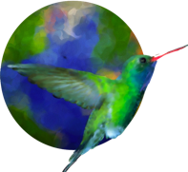
The Blue Economy is a physics and systems based approach to sustainable development inspired by nature.
It has a zero waste approach to economic development that unleashes creativity and entrepreneurship.
100+ innovations set to generate 100m new jobs in 10 years.
3,500 scientists world wide make up the Think tank – We are the Do Tank.
Notes:
24 years….1994

Slide 3
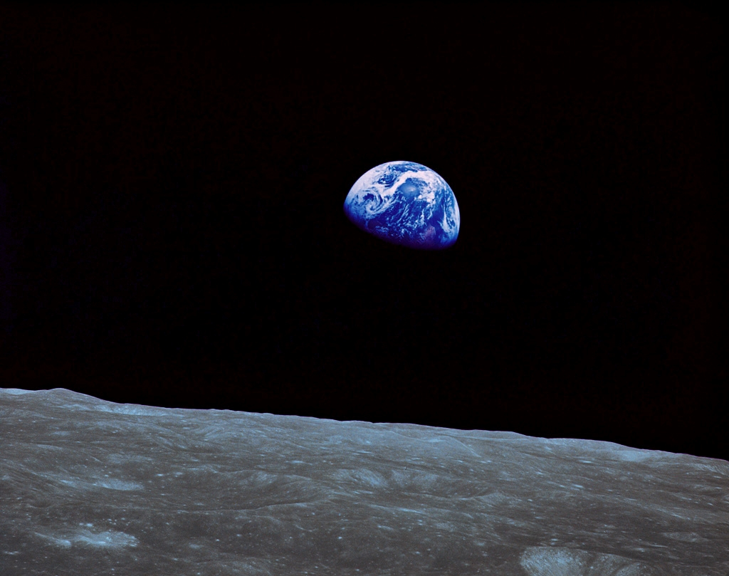
The Blue Planet
where everyone and everything is connected
Photo - Earth Rising, Source: NASA
Notes:
Look from space – one system – known as the blue planet. So when we talk about the blue economy – it’s one living system where everything and everyone is interconnected.
Photo of Earth (known as Earth rising) taken from the moon by Apollo 8, December 22, 1968 by astronaut Bill Anders. The photo was the first to show Earth from this perspective, and demonstrates the fragility and finite nature of Earth. It also showed how it’s a blue earth not a green one. We are ¾’s water – a delicate system of systems.

Slide 4
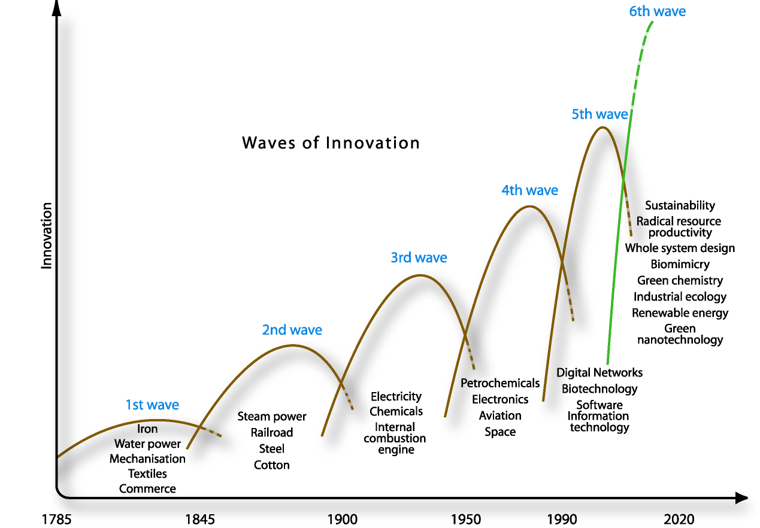
The Blue Economy contains all the elements of the 6th wave of innovation
(as defined by the Natural Edge) + new economic models.
Notes:
The Blue Economy is a physics and systems based, zero waste approach to economic development that unleashes creativity and entrepreneurship. The economic model emulates natural systems where industrial activities are clustered with cascading flows of material and energy, in order to dramatically increase humanity’s capacity to respond to the basic needs of all. It stands on the shoulders of the green economy and uses radical recovery of resources, upcycling of waste (as opposed to burning or dumping), using renewable sources of energy along with green chemistry and green nanotechnology to restore ecosystems, build the economy and generate prosperity for all.

Slide 5
Belief we have a design problem rather than a waste or pollution problem.
Focus on re-use, recycling, up-cycling, closed loop systems – innovation inspired by nature.
Incorporates purpose economy that focuses on values and purpose in business – and share economy in that we don’t need to own all our assets.
Shifting to new economy where the world moves from heavy industry to innovative new designs & biomimicry.
Notes:
No in built redundency

Slide 6
Green
Linear
Expensive
Can create waste and unintended consequences
Subsidised
Taxes
Cut Costs
Elitist
Scarcity mentality
Sacrifice so others may learn and grow
Blue
Physics and Systems led with
multiple benefits
Innovative
Zero waste
Competitive
Jobs
Adds more value
More equitable
Abundance mentality
Sharing to create community and win:win:win scenarios
Notes:
Sacrifice your self so that others may learn and grow V sharing yourself to build community
The sharing economy and how people are moving away from accumulating to creating experiences with their lives. "We have still an economic paradigm that suggests that the best way to build an economy, a society and civilization is to beat the crap out of each other in business

Slide 7
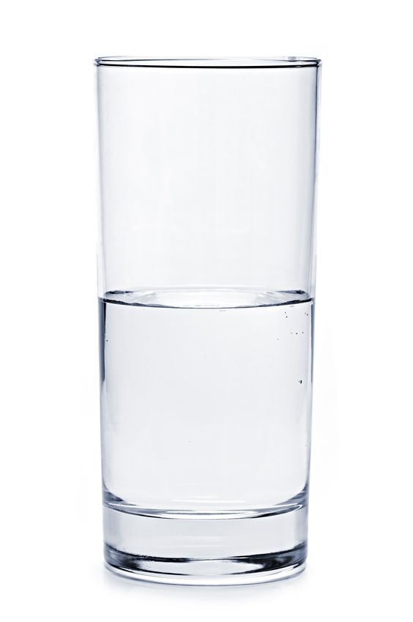
Notes:
Lets start by looking at things a little differently. The ambition of the Blue Economy is to enable and evolve new models of sustainability. This is only possible, only when we can have a paradigm shift in both our thoughts and our values. Represents what you will achieve today – when you leave, you will be fuller than you can see with opportunity and information.

Slide 8
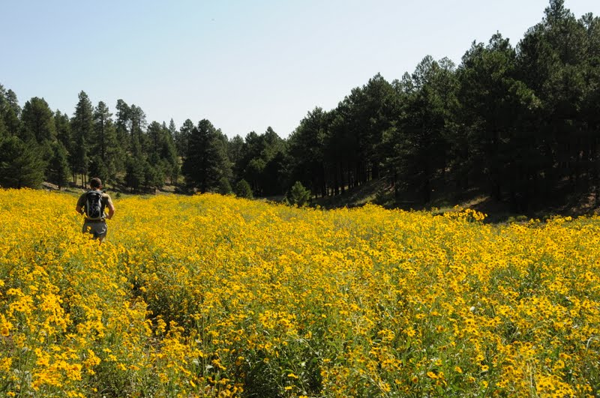
Notes:
What’s the most abundant source of energy here? Not not the sun, or the flowers - it’s Gravity – the largest source of renewable energy and it’s totally unexploited! Solar is second – gravity first.

Slide 9
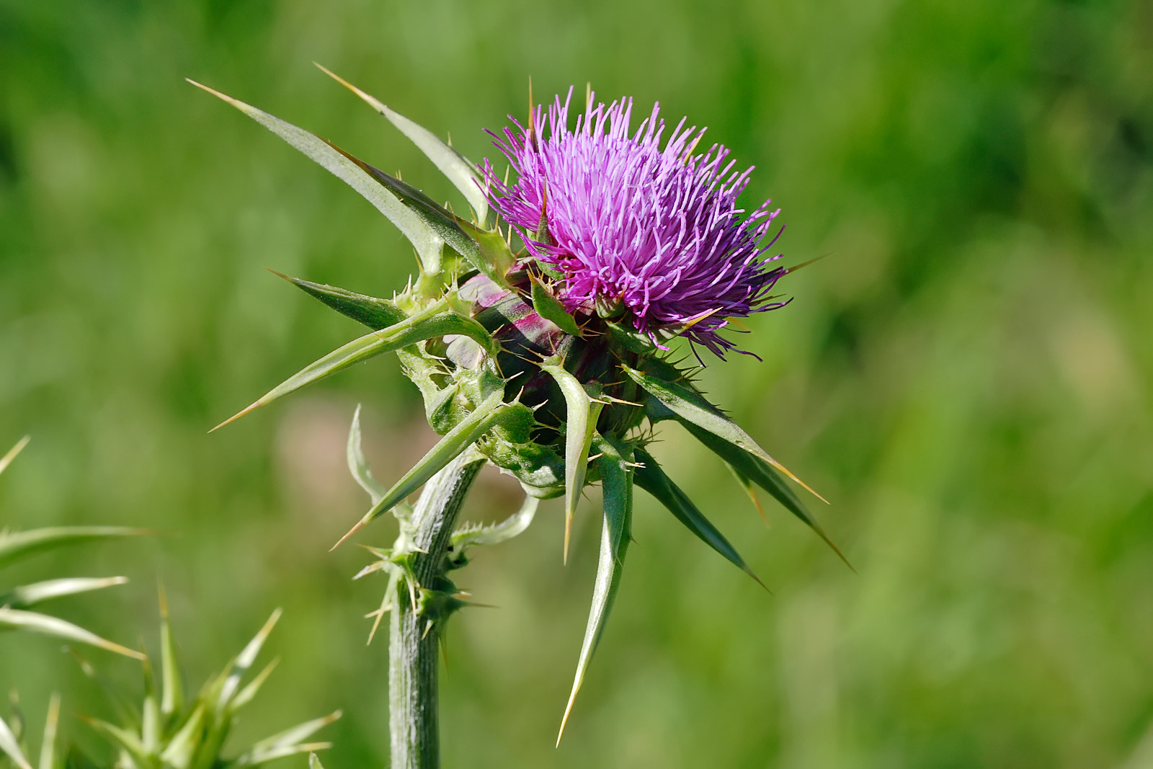
Notes:
Thistles, a noxious weed. Worth? What can you do with it? Source of oil - 8 types of oil
becomes the raw ingredient to produce innovative optimizing bio-plastics, which offer a much higher added value compared to using it to produce energy and biofuels. One Tonne Thistles is worth $3,700!!!!!!
The record wheat price for Australia was $440 a tonne in 2004, while APW wheat delivered to Melbourne in September 2019 fetched $425 a tonne.

Slide 10
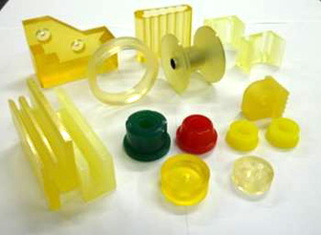
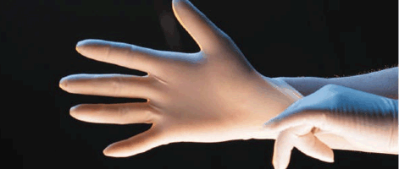
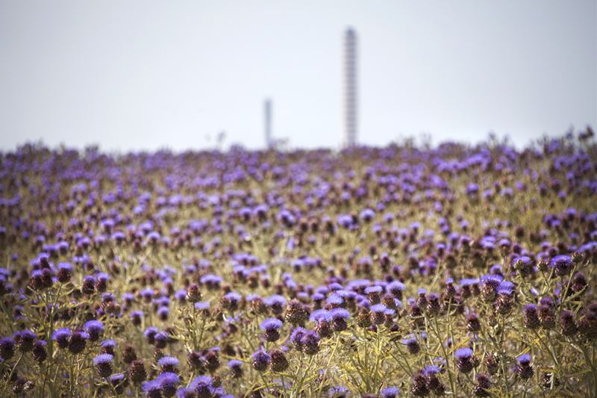
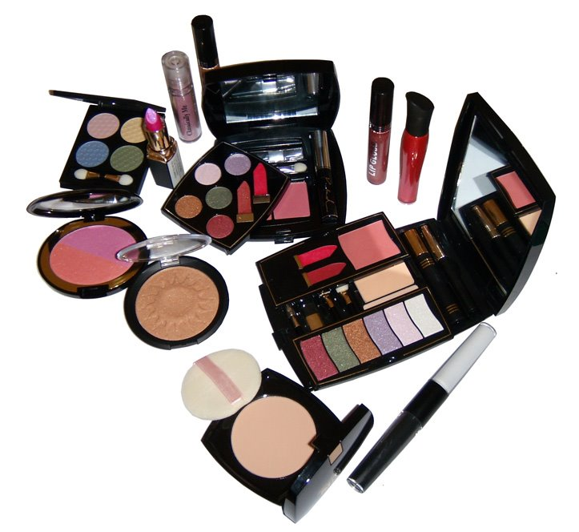
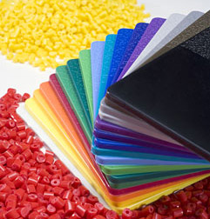
$600m sales year one.
8 types of oil.
Esters include lubricants, cosmetics, plastics, resins, explosives, bio-fuel, surfactants and synthesis of various industrial chemicals.
Elastomers - a polymer with viscoelasticity (having both viscosity and elasticity). Global revenues for rubbers are forecast to rise to US$56 billion by 2020.
Notes:
Thistles, a noxious weed- becomes the raw ingredient to produce innovative optimizing bio-plastics, which offer a much higher added value compared to using it to produce energy and biofuels. One Tonne Thistles is worth $3,700!!!!!!

Slide 11
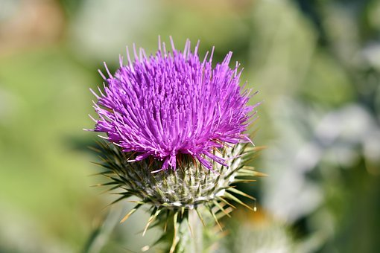
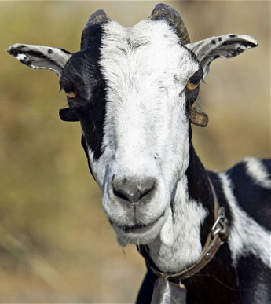
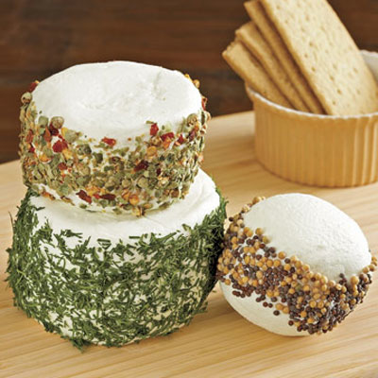
Notes:
Enzyeme on the flowers of thistles needed to make goats cheese. Relaunching cheese industry in Sardinia from a local weed people want to kill with chemicals. Farmers paid not to farm because of them.

Slide 12
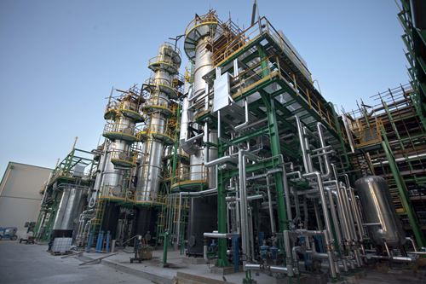
Oil from thistles blended with other sources, including olive oil residue and used cooking oils, and form the basis of third-generation Mater-Bi biopolymers.
50 per cent of the feedstock = Thistles grown on ´low-value, unproductive water scarce abandoned land (70,000 hectares). After extracting oil from the seeds, the remaining material is used by local farmers as animal feed, while the biomass is used to fuel the plant itself.
Notes:
The initial phase of the project has seen thistles cultivated on 400 hectares (988 acres) of land by 40 local farmers, while the final industrial process will require around 20,000 hectares (49,421 acres) to grow the thistle fraction of the feedstock.
Matrìca has already seen investment of €180 million (£142 million) and the creation of a research centre and seven pilot plants, as well as a full-scale biomonomer plant, which opened in June 2014.
Over the next few weeks, two more plants on the 27-hectare (67-acre) site – a polymers and rubbers additive plant and an esterification cycle facility – will also come on stream, and it is anticipated that ´the entire integrated production chain´ will be completed by 2016.

Slide 13
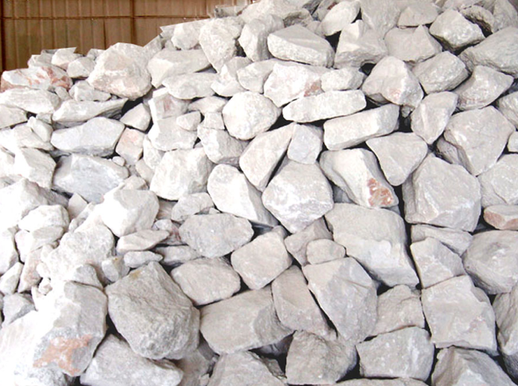
Notes:
The starting point is the supply of rocks. While calcium carbonate rich stones are the reference, it is possible to use a wide variety of mineral sources provided that the input material meets the standard size of fine dust. The crushing installation valued at a capital investment of $10 million provides a core material transported through a pipeline to avoid the generation of dust at the pellet production unit. The stone dust is mixed with 20% polyethylene, today a virgin material to be replaced by a recycled PE, and ultimately by a bio-based PE generating more value for the local farmers and creating a higher impact in the region that now can reconnect farming and mining with industrial production.
The investment cost of equipment is estimated at $150 million, 40% less than a traditional paper plant for equivalent volume (120,000 T/a). The reason for this considerable reduction of capital requirements is due to the fact that no water nor water treatment is needed. This subsequently reduces energy demand. In addition, the cost of pulp is replaced by a low cost crushed stone seldom costing more than $200/T. However, it must be pointed out that virgin PE costs $1,500/T which is double the fiber cost. Since the percentage of PE can range from 20-40%, the overall cost of raw materials by weight can be up
to 40% lower than standard fiber-based paper. The stone paper rolls or sheets are delivered to "converter" companies that produce notebooks, paper bags, golf score cards, children's books, packaging and wrapping paper even humidifiers and medicine boxes. While the factory in Benxi City (near Shenyang) starts with a production capacity of 120,000T/a, it is set to increase to one million ton, good for one thousand jobs.

Slide 14
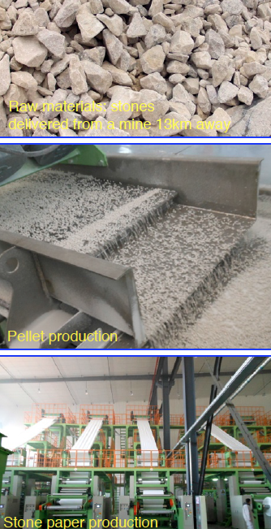
Stone Paper - Paper made without trees that is recycled for ever…
Notes:
Investment costs about $150m – about 40% less than a traditional paper plant for equivalent volume. Considerable reduction of capital requirements because no water or water treatment is needed.
Rich Mineral Paper (Rockstock) is neither pulp nor synthetic made paper. Rich Mineral Paper is a combination largely (80.9%) of mineral powder (Calcium Carbonate) with a small amount (18%approx) of a non-toxic, recyclable, compostable, photodegradable resin (PE) to create an extremely environmentally friendly paper. Boards and other rockstock Products may have different proportions of Stone powder and resin to achieve different performance.
Due to this unique make up, Rich Mineral Paper (Rockstock) is made with minimal consequences to the environment. Not only is Rich Mineral Paper (Rockstock) a “Tree-Free” product, but also does not require water or use of fossil fuel as part of production. This break through product does not require bleach, or use strong acid to lighten or break down the components used to produce the Paper.
As a result the mills have been able to achieve something that no pulp based paper mills have been able to achieve. Rich Mineral Stone Paper mills create no air pollution, no toxic run off and no water pollution. No acid, base or bleach. No Halogens or phalates.

Slide 15
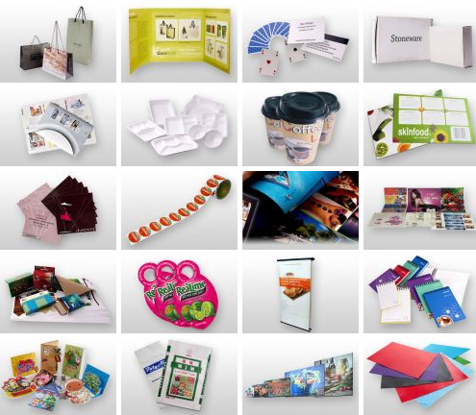
Notes:
Stone-Paper is energy efficient, acid free paper that is neither synthetic nor wood pulp fibre based. Stone-Paper is a natural product manufactured from calcium carbonate, CaCO3 powder using proprietary additives as a bonding agent.
80.9% of the paper is made up of waste from the building industry - offcuts and waste stone rock, marble and tiles as well as waste material at existing limestone quarries are ground to recover Calcium Carbonate.
Advantages - Anti Static - Acid Free - No Grain Direction - Water Resistant - Grease Resistant - Tear Resistant - Insect Resistant
Rockstock is the registered trade-name of a ground-breaking high quality, coated paper with outstanding environmental values that prints extremely well using standard inks.(No special inks are required.)
It can be used in most situations where conventional and synthetic paper is used and offers exceptional printing, water proofing and tear resistant qualities. Rockstock claims to be the world's most environmentally friendly paper. It is manufactured from ground down waste stone and offcuts used in the building industry. It contains no wood fibre.
Rockstock has a low carbon emission - It uses significantly less energy to produce than wood fibre paper. - It generates no effluent in its manufacture.(airborne or solid)
It requires no water, acid, base or bleach during production. - Any trimmings or waste paper from production is recycled to make new paper. - It is both recyclable and photo-degradable - Compostable (Commercial). 2 product ranges 1. S-Class (Sustainable Range) 2. R-Class (recycled Range
Sometimes confused with synthetic paper, Rockstock is neither synthetic nor pulp or fibre based and is termed "Rich Mineral Paper". Rockstock has qualities of both pulp and synthetic papers, but more importantly it is much more environmentaly friendly than either of the two. The printing qualities and exclusive feel make Rockstock a paper product not seen the likes of previously.
Due to its absorbency attributes, it has superior handling and printing qualities.
It is also water, mist, grease, anti-moth and insect proof*, freezer grade, and can be heat sealed(certain products apply).
As it is food grade*, Rockstock is suitable for thermoforming food trays, containers and in mould labelling.
Rockstock has unusual physical strength and high fold durability.

Slide 16
The production cost of stone paper is 40% less than traditional Paper.

Slide 17
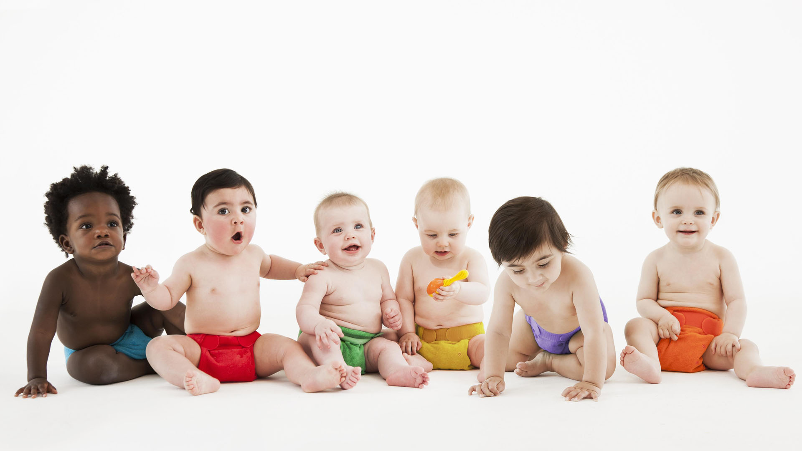
Notes:
3 to 8 % landfill is nappies. Wasted nutrient. Business opportunity…
Methane, 3000+ dirty nappies National Geograchic did a study that said the average American uses 3796 in a lifetime.
However If the average baby is potty trained at 2 1/2 years 3796 would be only 4 diaper changes per day. At 6 diapers per day for 2 1/2 years a closer number will be 5,475 - even that is a short estimate. National Geograchic did a study that said the average American uses 3796 in a lifetime.
We’ve looked at nutrients – now we look at innovation and how it opens the door to entrepreneurship…
While Mexico is turning used nappies into roof tiles, Scotland is concerting them into park benches and railway sleepers – what could a local business do with them in the region? 100 customers break event

Slide 18
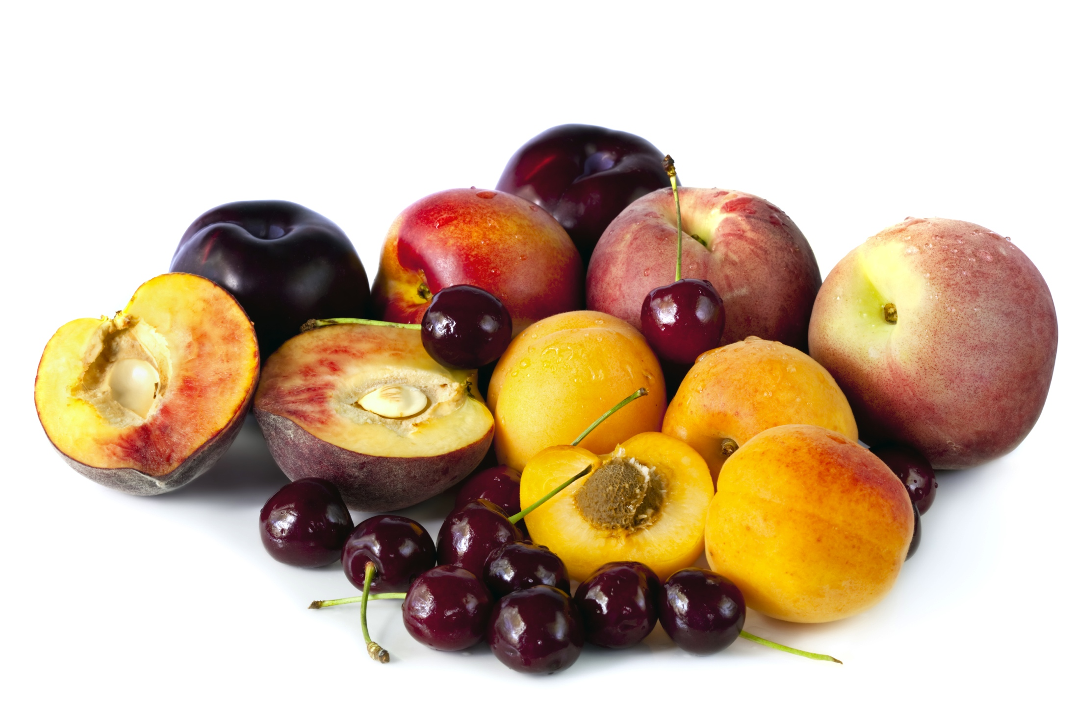

Slide 19
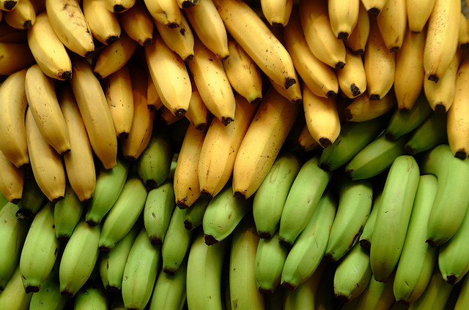
Notes:
About 50% of worlds food is waste….imperfect, past use by date, old but still good….

Slide 20
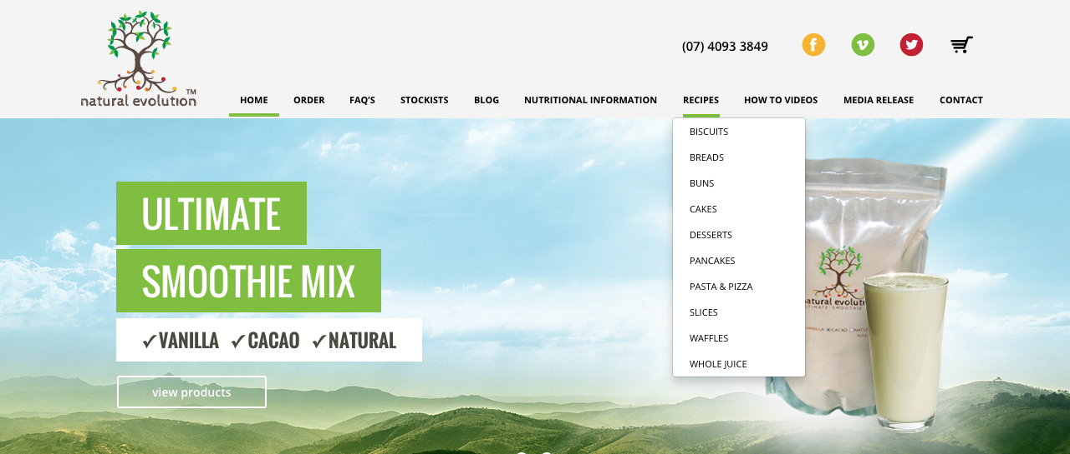
Notes:
Good Business – not rocket science but not everyone can see the value in what they have. The Blue Economy helps people see the value.
Banana growers in the North now getting better money selling their bananas to Natural Evolution than to coles and woolies.

Slide 21
Notes:
Great natural fertlizers – there is much more we can do with this….especially with a growing population.

Slide 22
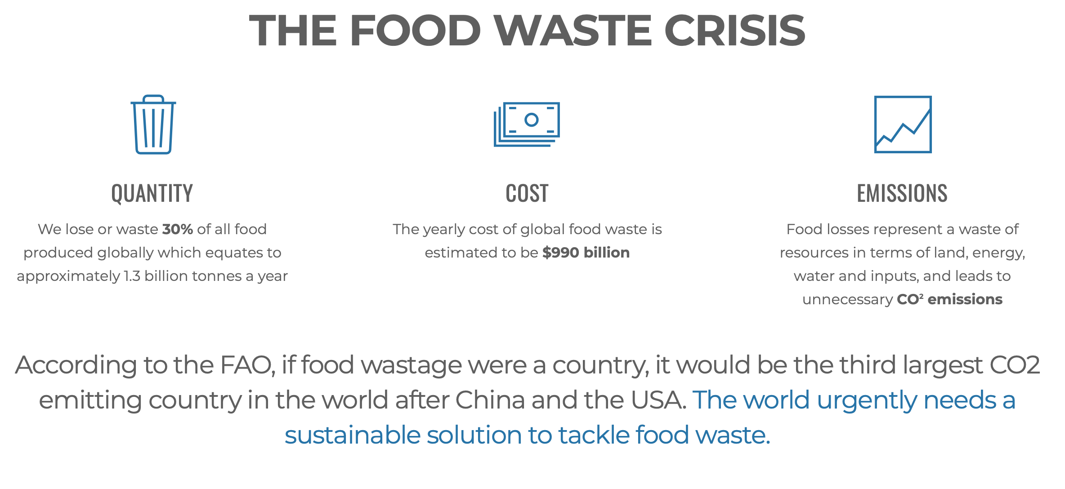

Slide 23
Notes:
Many companies including AgriProtein are pioneering waste-to-nutrient insect technology using back soldier larvae to upcycle organic waste into premium and sustainable protein for animal feed. Our process has been tried and tested by Mother Nature for almost 240 million years. Since the Triassic period, nature’s over 125,000 species of flies have broken down, recycled and cleaned up waste. In turn, flies and the larvae from which they emerge, are the natural food of many types of animals including fish, birds and mammals.

Slide 24
Notes:
After the maggots feed on the waste, they are washed, dried and grounded to produce a product that is high in protein and used for feeding chickens, fish, quail and pigs.
AgriProtein’s maggot-based animal feed is more than 15 percent cheaper than other alternatives and has been proven to be highly nutritious for livestock.
The company recently attracted more than $10 million in capital to build more fly farms in South Africa. In fact, the German government has offered AgriProtein one million Euros to set up a plant in Germany.

Slide 25
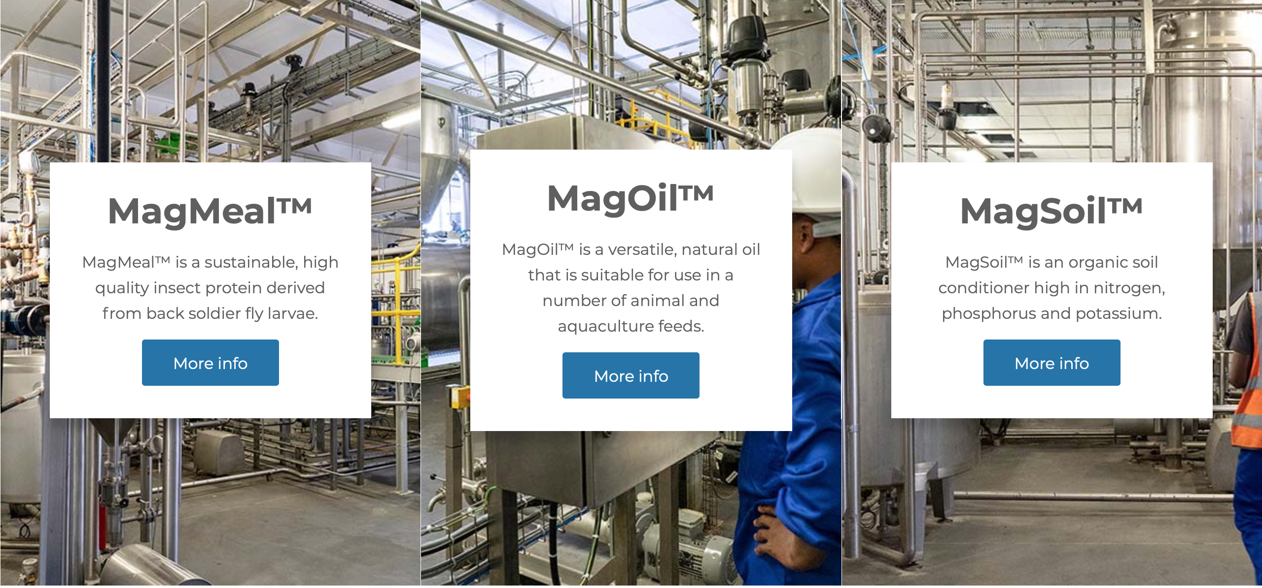
Notes:
upcycle organic waste into premium and sustainable protein for animal feed.
Our process has been tried and tested by Mother Nature for almost 240 million years. Since the Triassic period, nature’s over 125,000 species of flies have broken down, recycled and cleaned up waste. In turn, flies and the larvae from which they emerge, are the natural food of many types of animals including fish, birds and mammals.

Slide 26
The international trade in animal feed has an estimated turnover of $400 billion every year.
Notes:
AgriProtein’s maggot-based animal feed is more than 15 percent cheaper than other alternatives and has been proven to be highly nutritious for livestock.
The company recently attracted more than $10 million in capital to build more fly farms in South Africa. In fact, the German government has offered AgriProtein one million Euros to set up a plant in Germany.

Slide 27
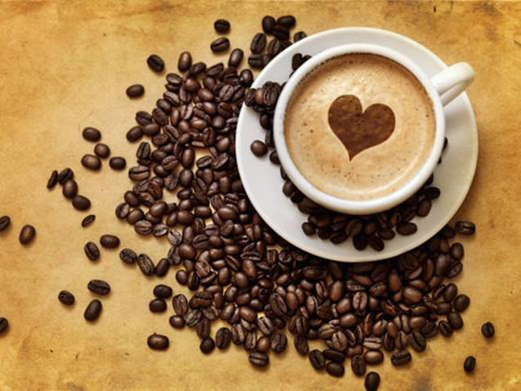

Slide 28
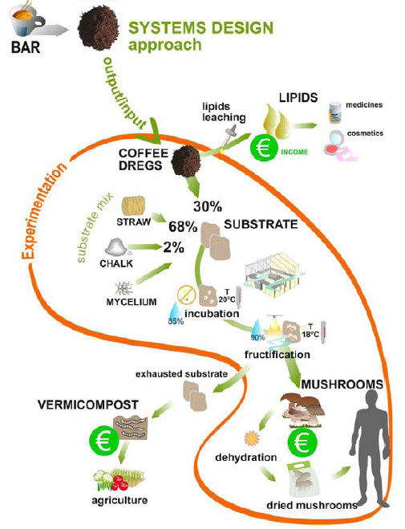
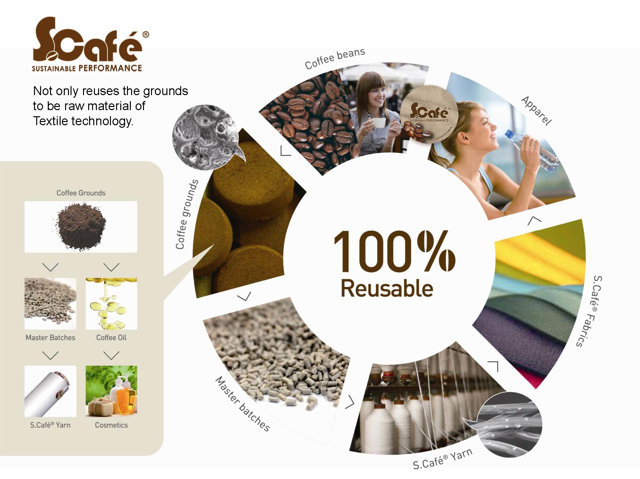
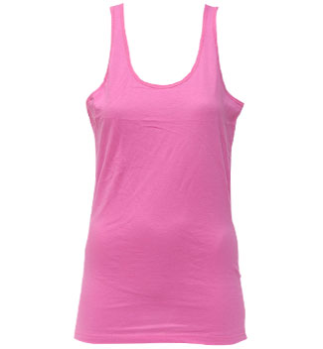
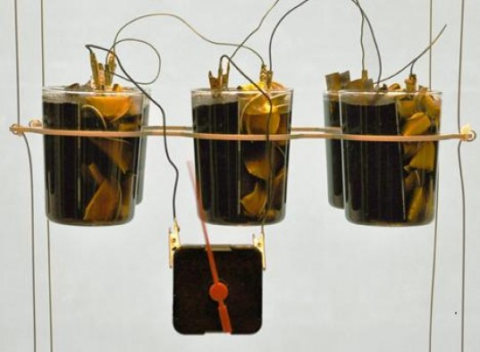
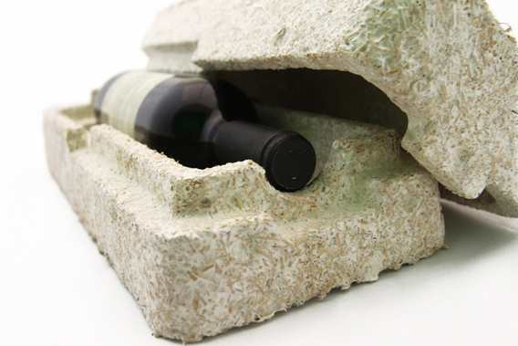
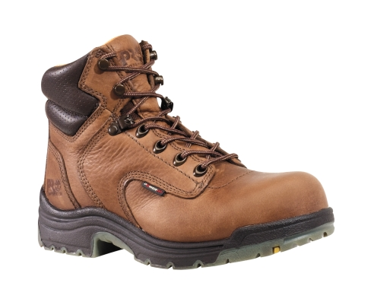
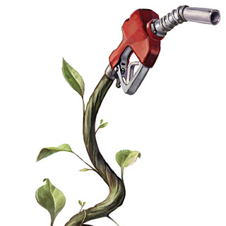
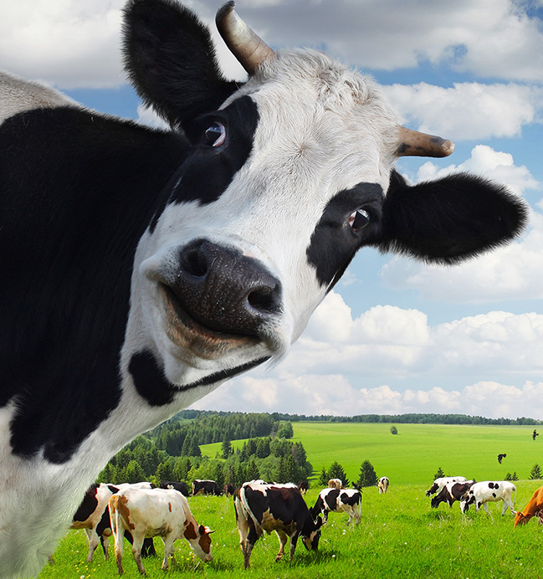
TEXTILES
99.8% WASTED
BATTERIES
PACKAGING
Odour Absorbing Paint
Odour absorbing shoes
BIOFUEL
animal fodder
Compost
Source: Systemic Design, Luigi Bistagnino
Notes:
Turning waste into taste. Growing mushroooms across Paris to provide employment and local produce. Can grow in old shipping containers, basements etc. Work with Ivanka M

Slide 30
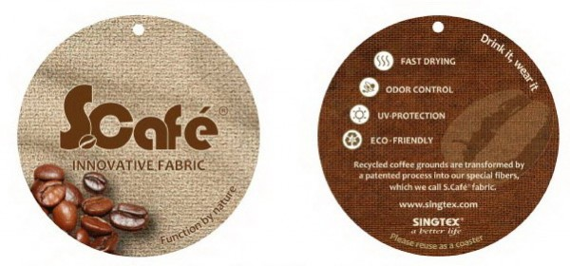
Drink it - Wear it
One cup of coffee can be turned into two T.Shirts
Notes:
Open the door to new industries. How many cafes are there in Melbourne?
Every month, Singtex collects around 300kg to 400kg of waste coffee grounds for free from Starbucks and churns them into fabrics.
The future is bright for the reuse of waste coffee grounds not just in fabrics, but also in shoe soles, socks, luggage, soaps and a slew of other products. The company patented S.Cafe fabric nanotechnology and was the world’s first mill to produce this eco-friendly textile.
Singtex produces sports wear for Nike Inc, North Face Inc, Patagonia Inc, Adidas AG and Puma AG.
S.Cafe beats Gore-Tex fabrics in terms of UV protection, faster drying time, odor control and better pricing point,”

Slide 31
© Anne-Maree Huxley, MOSS and the Blue Economy Institute 2014. All Rights Reserved.

Slide 33
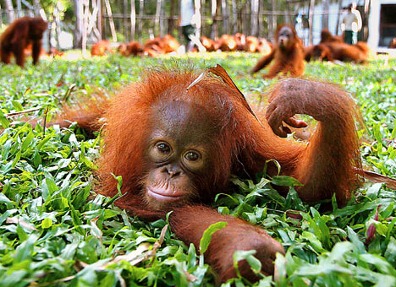
KEY LEARNING
Natural, Biodegradable and Renewable DOES NOT equal sustainable.
Notes:
Biodegradable – everything will in time -3 days 300 years. We need to look beyond ecological process to an ecological system to really innovate. Biobased economy moved to mineral based.
If being a thief and saying I’m only going to steal cash, TV’s, mobile phones and computers – no longer going to steal cars or CD’s – does that make someone less bad?
Are Universities doing less bad perpetuation the same thinking that’s put us in the predicament we are currently in? I would suggest they are….

Slide 34
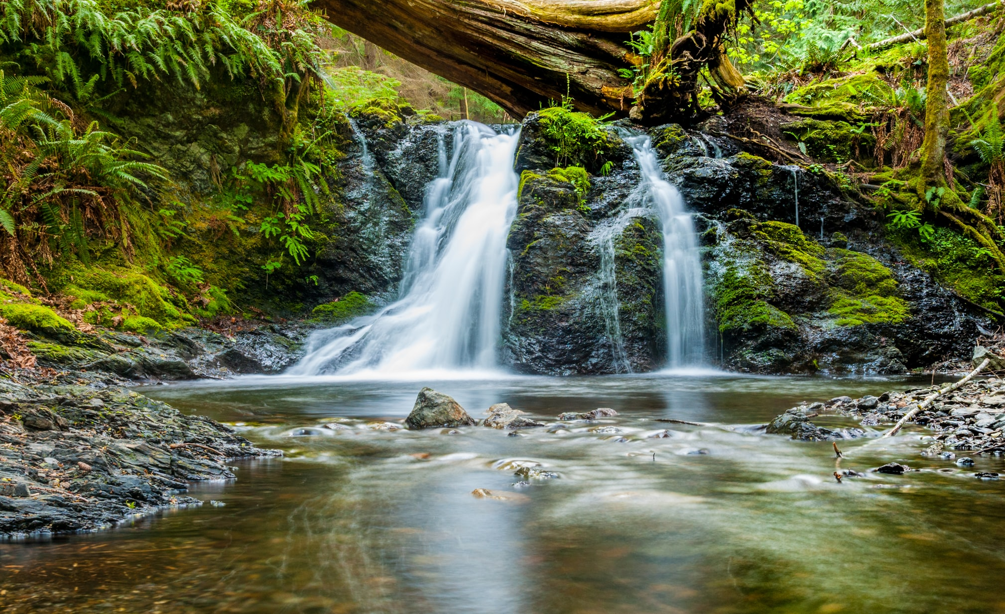
21 Principles
In nature – water, air and soil are the commons free and abundant.
Notes:
Water emerging from some deep ground water, may have fallen as rain many tens, hundreds, thousands of years ago. Soil and rock layers naturally filter the ground water to a high degree of clarity, healthy soils = healthy ecosystems. – http://www.permamatrix.com/healthy-soil-gives-us-clean-air-and-water/
.

Slide 35
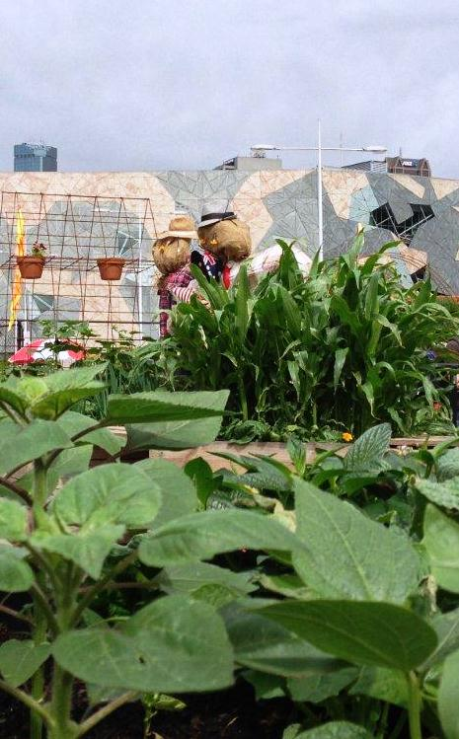
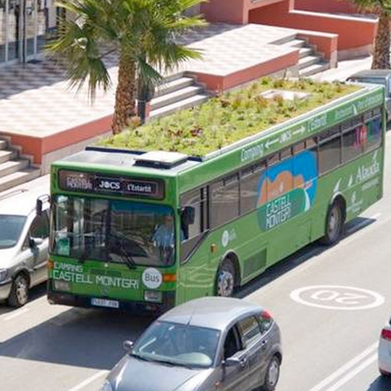
Urban agriculture using commons resources (rain) aids food security
Notes:
This eco-bus, dubbed the "Phyto Kinetic," was designed by landscape artist Marc Grañén of Barcelona, Spain in an effort to energize public buses with life, improve the urban ecosystem, and purify the air that city slickers breathe. Best of all, this roof top garden can be watered naturally or better still, by water from the vehicle's air conditioning system...
Melb pop up gardens
Paris Mayor Anne Hidalgo’s in addition to a green beltway through Paris, she wants to use the tunnels for farming fish and mushrooms - See more at: http://www.richardcyoung.com/essential-news/anne-hidalgo-paris-first-lady-mayor-good-start/
Container EUR60k pa

Slide 36
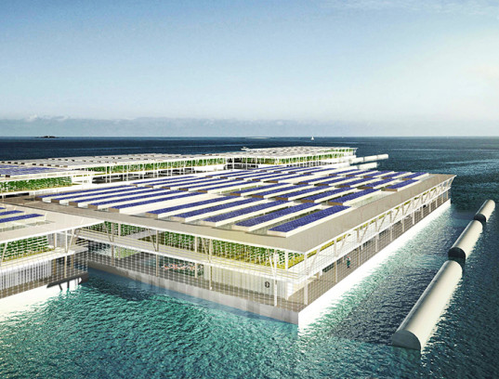
AQUAPONICS
Smart Floating Farms
Notes:
Harvesting sunshine and rain
Aquaponics is a combination of aquaculture, which is growing fish and other aquatic animals, and hydroponics which is growing plants without soil. Aquaponics uses these two in a symbiotic combination in which plants are fed the aquatic animals' discharge or waste.
Joined by walkways - With an increasing global population and a decreasing supply of arable land, providing sufficient food to meet demand is becoming increasingly more difficult. Barcelona-based design practice Forward Thinking Architecture proposes an innovative solution: Smart Floating Farms. Designed to complement traditional farming, these solar-powered and modular floating farms make use of underutilized water bodies to promote long-term food security and resilience.
Read more: Could solar-powered floating farms provide enough food for the entire world? | Inhabitat - Sustainable Design Innovation, Eco Architecture, Green Building

Slide 37
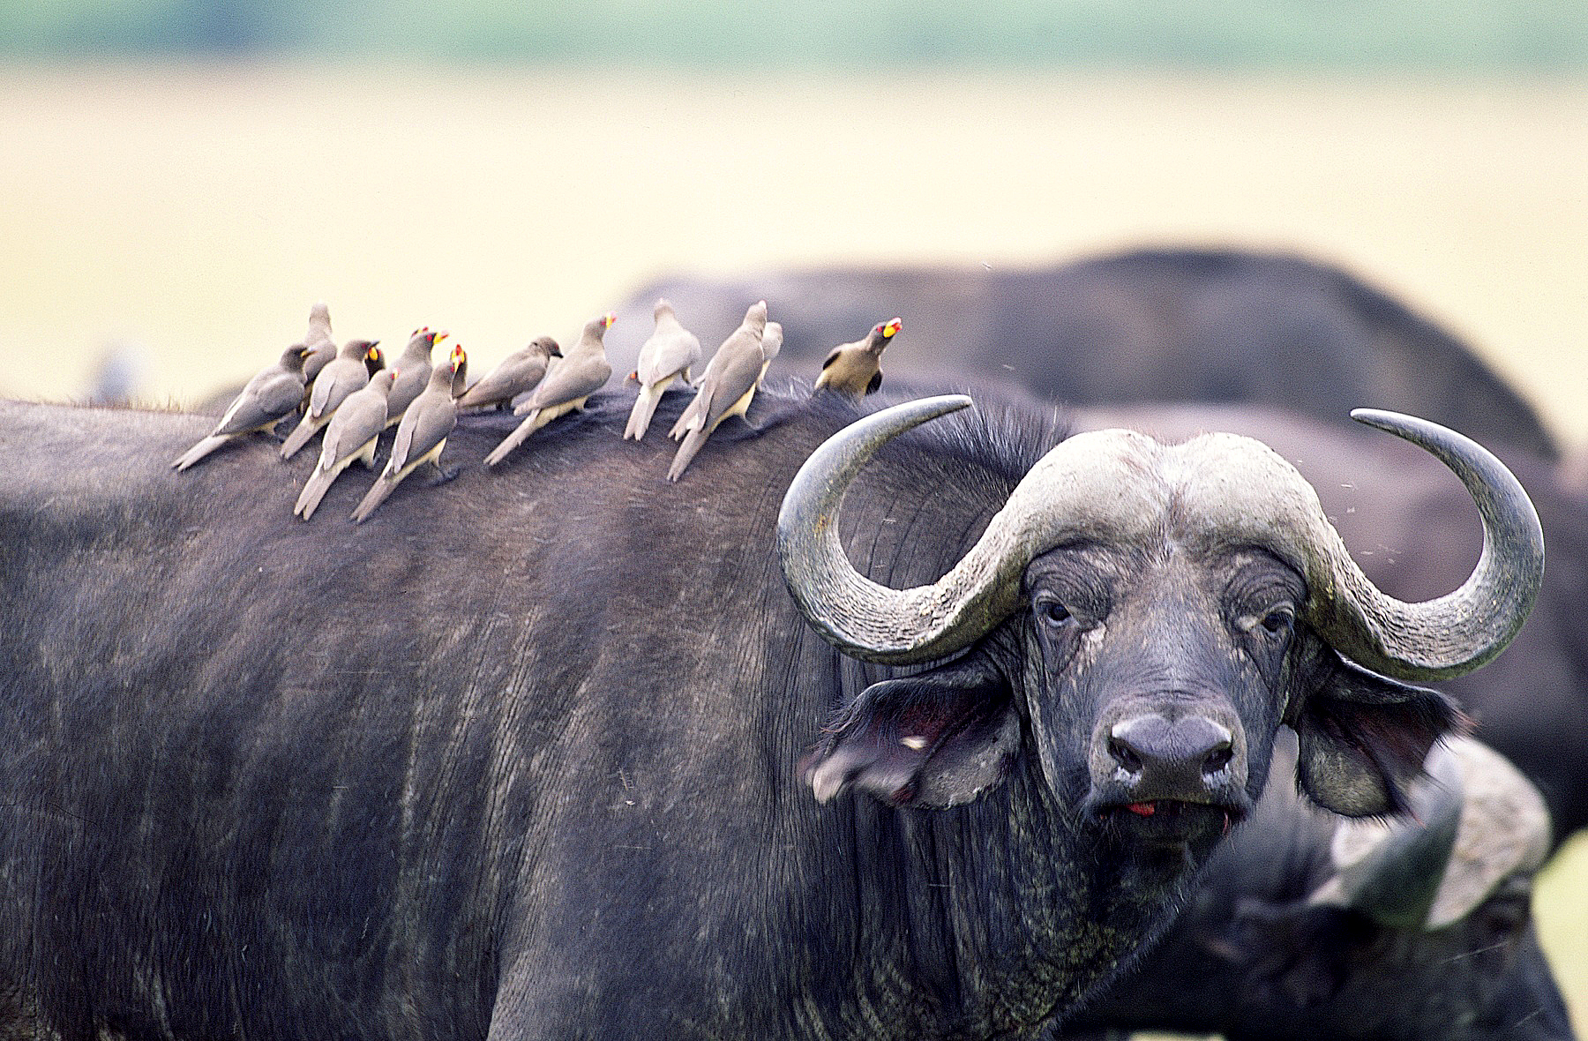
In nature everything is bio-degradable (it’s just a matter of time); everything is connected and evolving towards symbiosis.
In connected and evolving towards symbiosis.
In nature everything is bio-degradable (it’s just a matter of time) and everything is connected and evolving towards symbiosis.

Slide 38
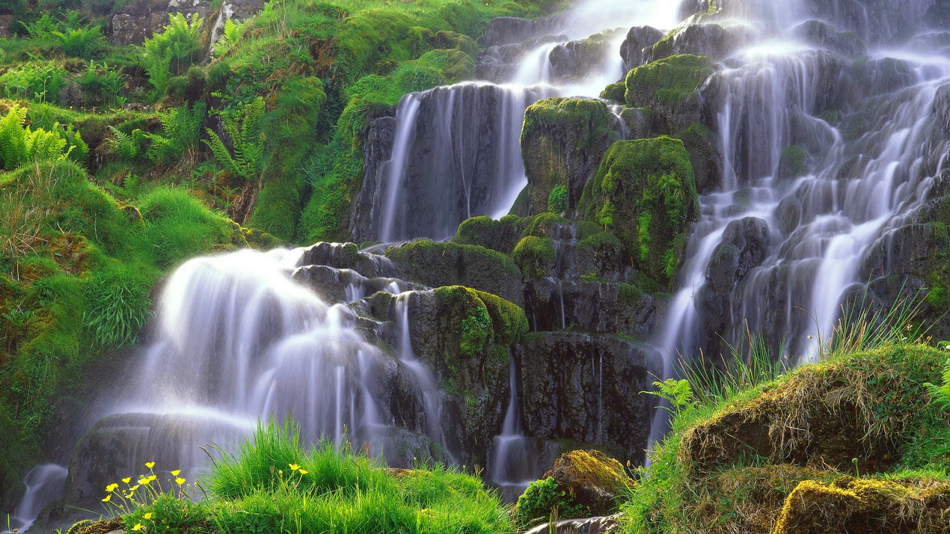
Natural systems are non linear – they cascade nutrients, matter and energy.
Gravity is the main source of energy, solar energy is the second renewable fuel.
Water is the primary solvent (no complex, chemical or toxic catalysts).
Notes:
Ecosystems provide pragmatic design principles for the new economy.
The first of these is based on the observation that all matter and energy cascades from one species to another. Such cascading of nutrients involves partaking of locally available resources, employing all contributors, and using the waste for one as the resource for another.

Slide 39
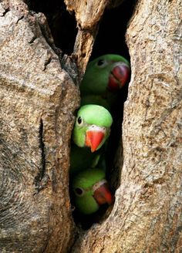
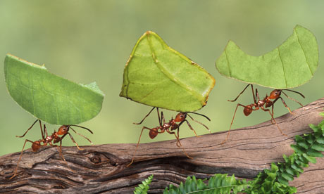
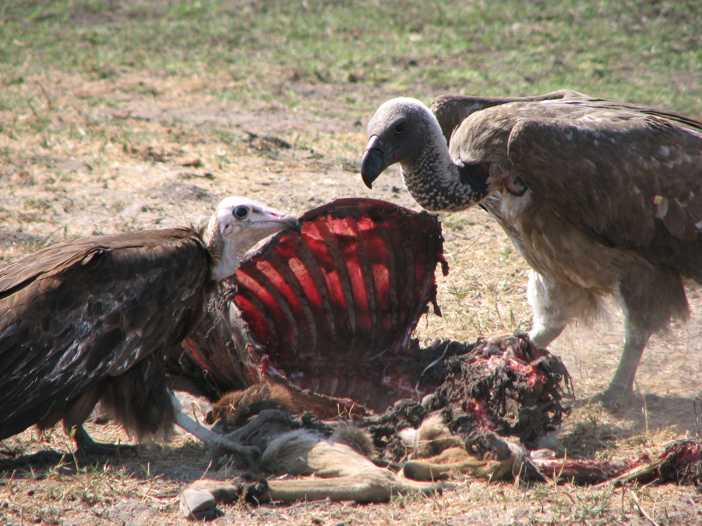
In nature one process generates multiple benefits and there is zero waste…
Waste does not exist in natural systems.
Notes:
In nature there is zero waste
Let’s design it right from the beginning to work with all the natural element. Nature can survive without us, but we can’t survive without nature.
Think in systems
Waste does not exist in natural systems. The ‘waste’ of an animal for example becomes nutrient for microbes, fungi, plants, trees, reptiles, mammals and so on.

Slide 40
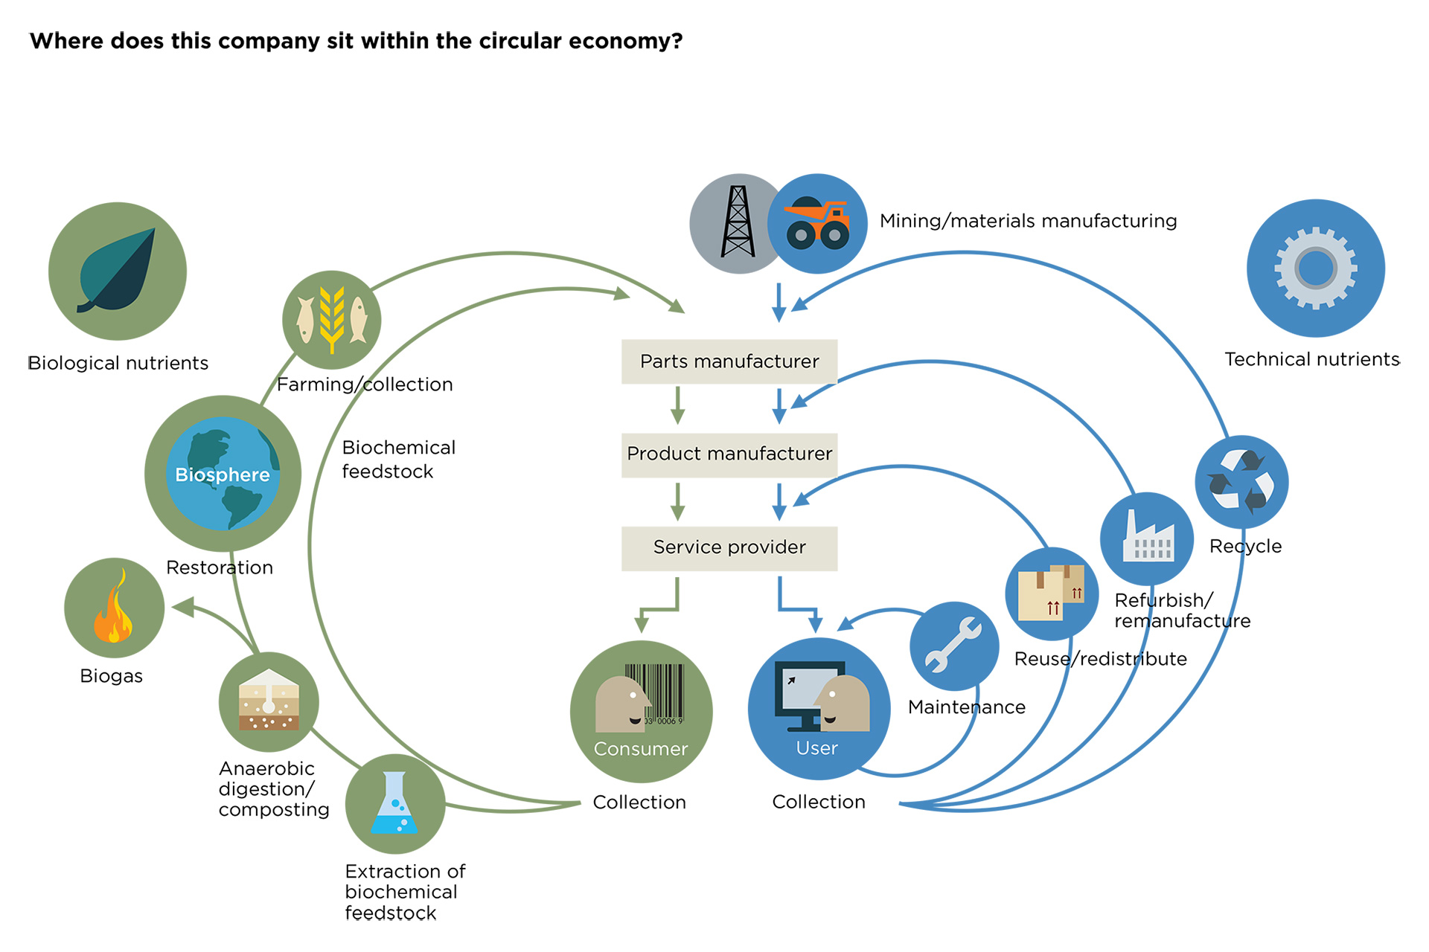
Materials become nutrients forever
Any by-product is the source for a new product.
Notes:
How zero wasteis achieved
Overshoot day Aug 19
For example the ‘waste’ of an animal becomes nutrient for microbes, fungi, plants, trees, reptiles, mammals and so on – perhaps even food for humans. This is a simple example of a biological nutrient cycle.

Slide 41
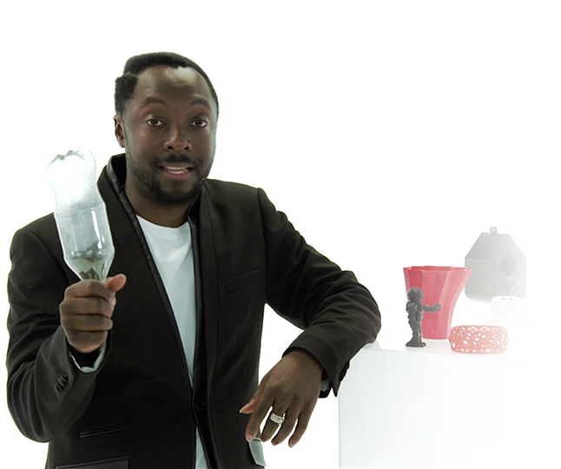
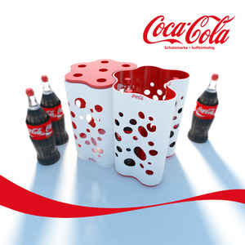
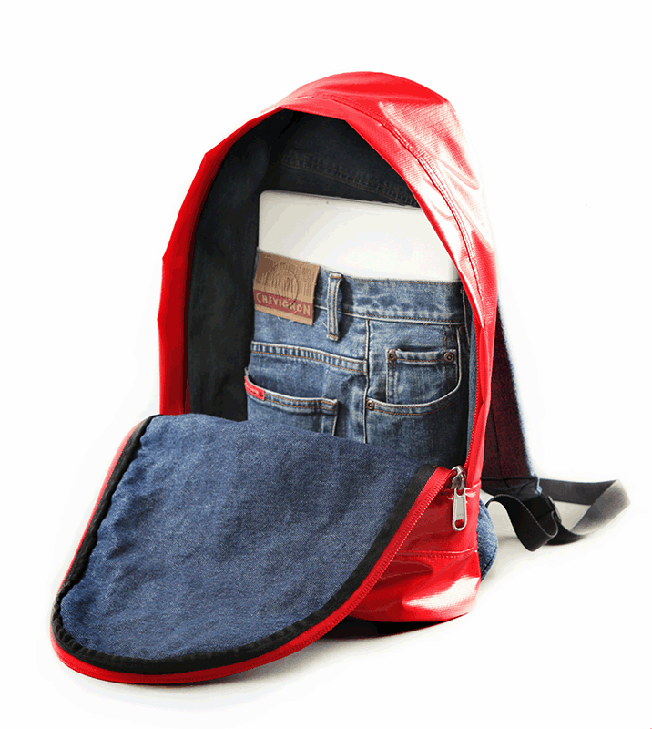
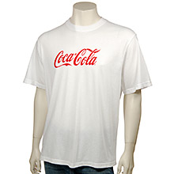
Technical Nutrients

Slide 42
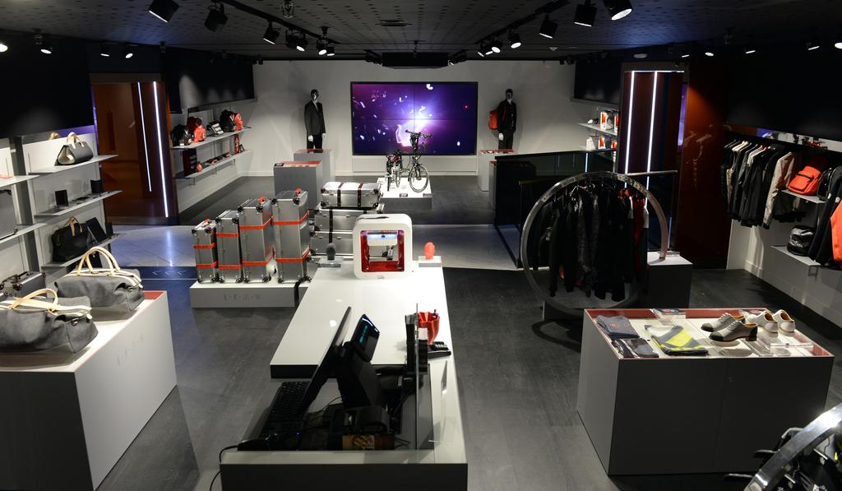
Ekocycle
Harrods, UK
Notes:
Will.I.Am Ekocycle focuses on sustainability and the recovery of post-consumer plastics and aluminium.
2017 - ‘I’m honoured to introduce the Ekocycle brand to the UK at Harrods and unveil a new group of “upcycled”, stylish and fun lifestyle products made partially from recycled materials. I encourage everyone to seek out items that use recycled materials like those featured in the Ekocycle products at Harrods.’

Slide 43
Biological Nutrients
Notes:
SIDER AND FRITZ – biological nutrient
Spiders eat insects – some naturally get caught in their webs turn flies into super strong threads with no toxic chemicals

Slide 44
1 tonne silk = 9 tonnes of fertlizer
Notes:
Mulberry trees grow in degraded land. Silk worms eat mulberry leaves. The silk is converted into spider silk - used as a substitute to titanium in medical and other products. The bi-product of growing silk is fertilizer.
Silk is purified to eliminate immunogenic components (particularly sericin) and is used to form tissue-supporting prosthetic devices for implantation. The fabrics can carry functional groups, drugs, and other biological reagents. Applications include hernia repair, tissue wall reconstruction, and organ support, such as bladder slings. The silk fibers are arranged in parallel and, optionally, intertwined (e.g., twisted) to form a construct; sericin may be extracted at any point during the formation of the fabric, leaving a construct of silk fibroin fibers having excellent tensile strength and other mechanical properties.
Reproduction of Spider Silk
While silkworms have been domesticated for mass production and industrialization for several centuries, spiders cannot be domesticated so easily. Spiders have an aggressive and solitary nature that leads them to cannibalism if confined in one space with other spiders -- silkworms can simply be fed mulberry leaves and observed (Forbes).

Slide 45
Mulberry silk is converted to spider silk using only pressure and moisture controls
just like the spider does. Photo: Courtesy of Oxford Biomaterials (UK)

Slide 47
Source: Voice of Russia, News.cnet.com
Photo: RIA Novosti
The world market for biocompatible devices already approx $20b annually with a growth rate of 10%.

Slide 48
Exercise
Notes:
Collective Intelligence - Thinking together We believe every problem in a living system requires a unique, non-mechanistic solution
Las Gaviotas & Il Hiro Focus on transforming the underlying system—not just symptoms Co-creation of answers Long-term commitment and partnership Capacity to create dialogue at all levels Willingness to address intractable issues - Most organizations have challenges that are uncomfortable to address: difficult leadership dynamics, failed strategies that people hold as successful, ethical challenges, maturation issues, cross-division or cross-functional conflicts. We help people go directly into areas they previously thought were unworkable, to generate new perspectives and achieve breakthroughs in results and capacity

Slide 49
Group One - Local community working in clusters to achieve zero waste, economic diversity, job creation, happiness and well being.
Builder
Upholster
Apple & pear orchid
Cottage industry hub
Childcare centre
6. Botanic gardens/nursery
7. Café restaurant
8. School
Menshed
Retirement village /nursing home

Slide 50
Group Two – Island business community working in clusters to achieve energy security, zero waste, economic diversity, job creation, happiness and well being.
Goat Farmer
Grocery story owner
Fruit Grower
Fisherman
Water Company
6. Local Economic Development Officer
7. Café restaurant
8. Tourism Operator
Energy Company
Waste Manager

Slide 51
Case study: El Hierro
Group Two Activity
Notes:
Exercise in Island sustainability

Slide 53
El Hierro's Golfo coastline
(Source: Karol Kozlowski via Shutterstock)

Slide 54
Notes:
El Hierro is the first self-sufficient island. An island where the trade winds are the main source of energy... and life. An example of sustainability in the archipelago of the Canary Islands – and in the world! Declared a UNESCO “World Biosphere Reserve and Geopark”, El Hierro is proud to say that the energy it uses is 100% renewable. This does not only mean that more respect is given to the environment, reducing CO2 emissions, but also that the islanders save tonnes of fuel a year.
The island has had a sustainable development plan since 1996 to guarantee an improved level and quality of life for the population and conservation of the nature areas.
El Hierro has unique geological and natural heritage, characterised by its landscapes and its volcanic origins. A well-loved and well-maintained place where the inhabitants ensure it remains unique and clean.

Slide 55
Gould League are offering programs on the Blue Economy for all ages/classes from K to year 12.
Let us help help make your school a driver of sustainability and economic in your community.
Notes:
Collective Intelligence - Thinking together We believe every problem in a living system requires a unique, non-mechanistic solution
Las Gaviotas & Il Hiro Focus on transforming the underlying system—not just symptoms Co-creation of answers Long-term commitment and partnership Capacity to create dialogue at all levels Willingness to address intractable issues - Most organizations have challenges that are uncomfortable to address: difficult leadership dynamics, failed strategies that people hold as successful, ethical challenges, maturation issues, cross-division or cross-functional conflicts. We help people go directly into areas they previously thought were unworkable, to generate new perspectives and achieve breakthroughs in results and capacity

Slide 56
Teacher Resources
Fact Sheets – Birds, Bees, Butterflies, Frogs, Trees, Lizards
New Standardized Bin Colours for Australia
purple for glass
lime green for FOGO
yellow for mixed recyclables
red for household rubbish
Compost Book How to green your school

Slide 58
For further information contact
Anne-Maree McInerney or Alix Ayton
gould@gould.org.au
0429 193 134 / 03 9585 7860
Notes:
Collective Intelligence - Thinking together We believe every problem in a living system requires a unique, non-mechanistic solution

