Slide 1
Why Bother about the Ocean?
The ocean covers 71% of the planet’s surface and houses the vast majority of life on earth.
Half of the oxygen on earth is produced in the ocean.
The ocean regulates our weather and the climate.
The ocean is the largest absorber and sequester of CO².
Australia’s ‘blue economy’ generates more than $118 billion each year and supports 462,000 jobs.
Australia’s ocean ‘territory’ (Exclusive Economic Zone) is larger than our land surface.

Slide 2
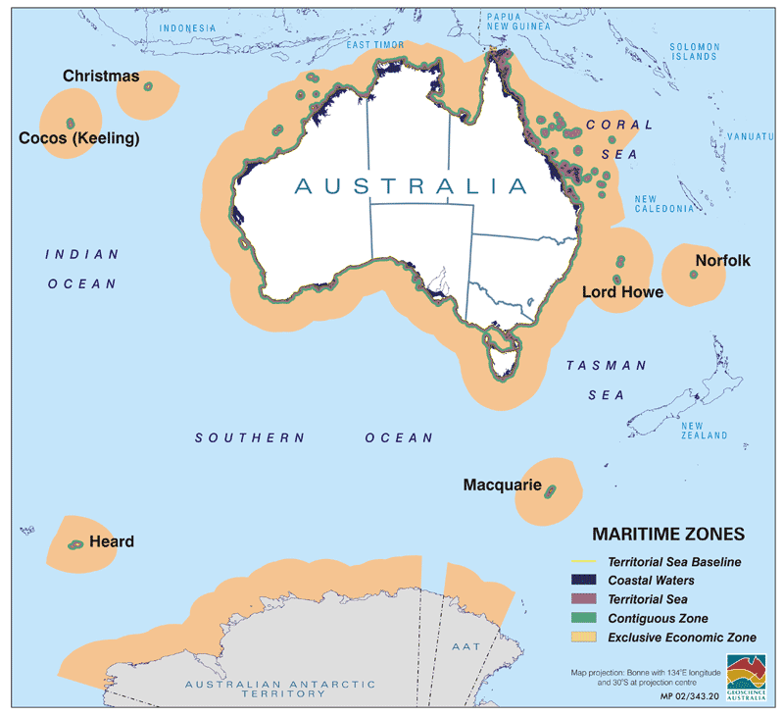

Slide 3
A Place for Ocean Education?
Ocean education has never been a major component in Australian schools because:
most Australian teachers feel they don’t have the expertise or knowledge to teach ocean themes;
ocean themes are almost completely absent from the Australian Curriculum & k-12 education documents;
there is no national consensus on what is important to include in the classroom;
there are currently no dedicated undergraduate ocean education units offered at Australian universities; and,
most Australians are still largely ignorant of the importance of the ocean in their lives.

Slide 4
The Response in the USA
Commencing in 2002, a diverse group of USA based ocean educators and scientists agreed to work towards developing a systematic approach to ocean education.
The concept of Ocean Literacy was defined in 2004.
By 2005 seven essential principles were identified and supported by underlying fundamental concepts.
From 2006 to 2009 scope and sequence guides were prepared for the 7 essential principles across school year levels K to 12 in the USA.
By 2012 the Ocean Literacy framework was aligned to the USA Next Generation Science Education Standards across year levels K to 12.

Slide 5
Ocean Literacy
Ocean Literacy is an understanding of the ocean’s influence on you and your influence on the ocean.
An ocean-literate person:
understands the essential principles and fundamental concepts about the ocean;
can communicate about the ocean in a meaningful way; and,
is able to make informed and responsible decisions regarding the ocean and its resources.

Slide 6
Seven Principles of Ocean Literacy
Earth has one big ocean with many features.
The ocean and life in the ocean shape the features of earth.
The ocean is a major influence on weather and climate.
The ocean makes earth habitable.
The ocean supports a great diversity of life and ecosystems.
The ocean and humans are inextricably interconnected.
The ocean is largely unexplored.

Slide 7
Scope and Sequence

Slide 8
Concept Flow

Slide 9
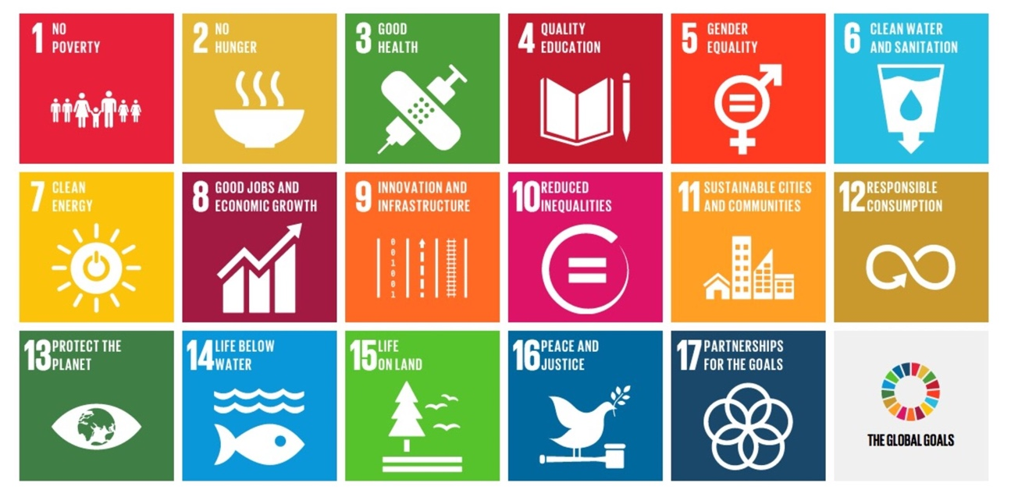
Ocean Literacy Goes Global
In 2010 the global uptake of Ocean Literacy began in the Pacific then spread to Australia, Europe, Canada, Asia, Africa and South America.
As part of this global uptake, UNESCO adopted Ocean Literacy and linked it to the UN Sustainable Development Goals - SDG 14.

Slide 10
Ocean Literacy and the UN Ocean Decade
The United Nations Decade of Ocean Science for Sustainable Development (2021 to 2030) has begun.
UNESCO-IOC has adopted Ocean Literacy as the framework for a world-wide educational component of the UN Ocean Decade.
UNESCO-IOC have set 14 clear Ocean Literacy targets for member nations (including Australia) eg.
By 2025, 70% of Member States have a National Ocean Literacy Strategy & integrate OL into the curriculum.
By 2030, 70% of all formal educators receive training and pedagogical tools to incorporate OL in the classroom.

Slide 11
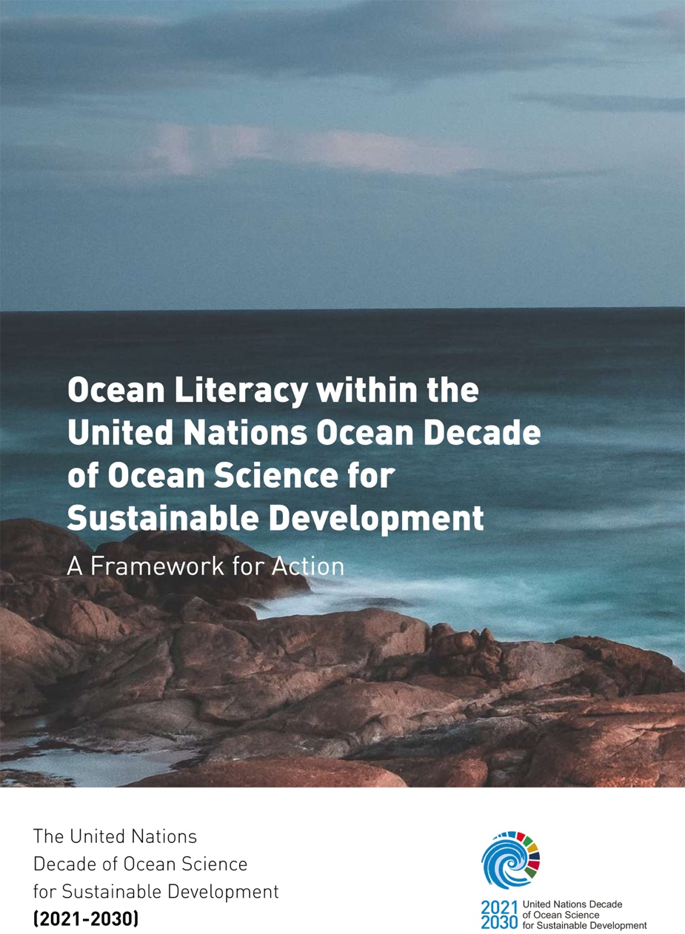
Framework for Action – Priority Areas
The UNESCO-IOC Framework For Action (2021) lists 4 priority areas:
Ocean Literacy in mainstream education policy formation.
Enhancing formal education.
Mobilizing corporate action.
Increasing community engagement.

Slide 12
Future Steps for OL in Oz
Identify & promote materials that support the integration of Ocean Literacy into the curriculum.
Continue to create tools for educators for easy insertion in the classroom.
Design and deliver undergraduate & professional development programs.
Incorporate traditional knowledge and indigenous views of ocean country.
Incorporate Ocean Literacy in national and state standards, assessments, and curricula in Australia.
Develop a Blue Schools network.

Slide 13
Some Good News
SeaWeek in Australia follows the 7 Ocean Literacy Principles – Seaweek 2024 will be March 9 to 16.
Although Australia does not have a National Ocean Office, DCCEEW is now working to develop a Sustainable Ocean Plan (including Ocean Literacy).
Anthony Albanese is one of 18 world leaders who make up the High Level Panel for a Sustainable Ocean.
Oceans IQ is working on developing a statewide Ocean Literacy web portal.
There will be an Ocean Literature Symposium as part of the AMSA conference in Hobart in September 2024.
AAEE will host the World Environmental Education Congress in Perth in Sept 2026 (OL one of 6 themes).

